Slide 1



Green Labs Meeting
November 11, 2022

Slide 2
Introductions

Slide 3
Updates
Asked Dianne Newman to be our Faculty Sponsor – she may be too busy
  We are asking DW to clarify role
  Victoria Orphan alternative
Talked with vendors (USA Sci etc) about hosting events
Talked with Kathy Ramirez-Aguilar from UCB and got lots of good tips
  Making positive “spins”
  Asking for funding for FT staff working on GLs and UG/G student workers
  Emailing new hires and participating in onboarding of G and UG
  Coordinating with EHS and Facilities
    And advertising that

Slide 4
Updates
We sent David Warren our budget proposal and website proposal
  He is flexible on funding, especially for pilots
    Suggested making the funding open-ended and the committee would ok
  Sounds like he is ok with us having our own website linked to the BBE website
  Suggested getting sponsors (like vendors) for products or meals etc
    We should try to work with vendors to get free or discounted items for giveaways
    Can ask them to sponsor lunch or something
  Is VERY keen to highlight accomplishments via newsletters, on the website etc so that should be a priority in 2023!

Slide 5
Lab Energy Audit
James Linton

Slide 6
Elowitz lab energy audit
Green Labs Committee Meeting 20221111

Slide 7
Why perform an energy audit?
To better understand resource demands of your lab
To reduce usage burden on lab equipment
To be better informed

Slide 8
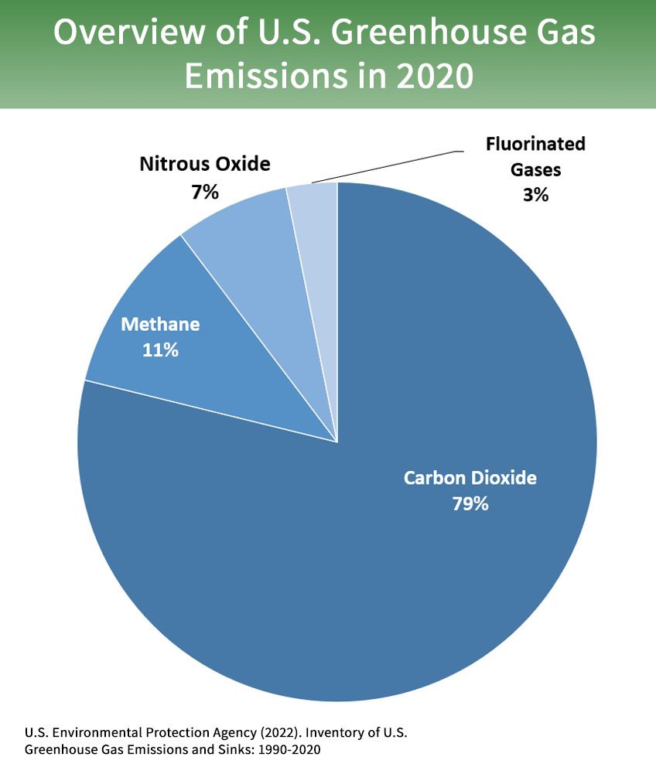
Managing carbon dioxide emissions is a challenge
1 kWh = 0.0004 metric ton of CO2
(eGRID, U.S. annual CO2 total output emission rate [lb/MWh], year 2019 data)

Slide 9
What is a kilowatt hour?
volt (joule/coulomb) x ampere (coulomb/sec) = watt = 1 joule/sec
1 kilowatt (kW) = 1000 joules/sec
1 kilowatt hour (kWh) = 3600000 joules = 860 calories

Slide 10
Caltech sources most of its energy from a cogeneration facility
10-megawatt natural-gas turbine and a 2.5-megawatt steam turbine
Pasadena Water and Power (PWP) sources most of its energy from coal-fired generation
(35% in FY22)
Fitch repors 2022

Slide 11
This audit has limitations
The audit is not metered
The audit does not account for fume hood usage
The audit does not account for animal husbandry

Slide 12
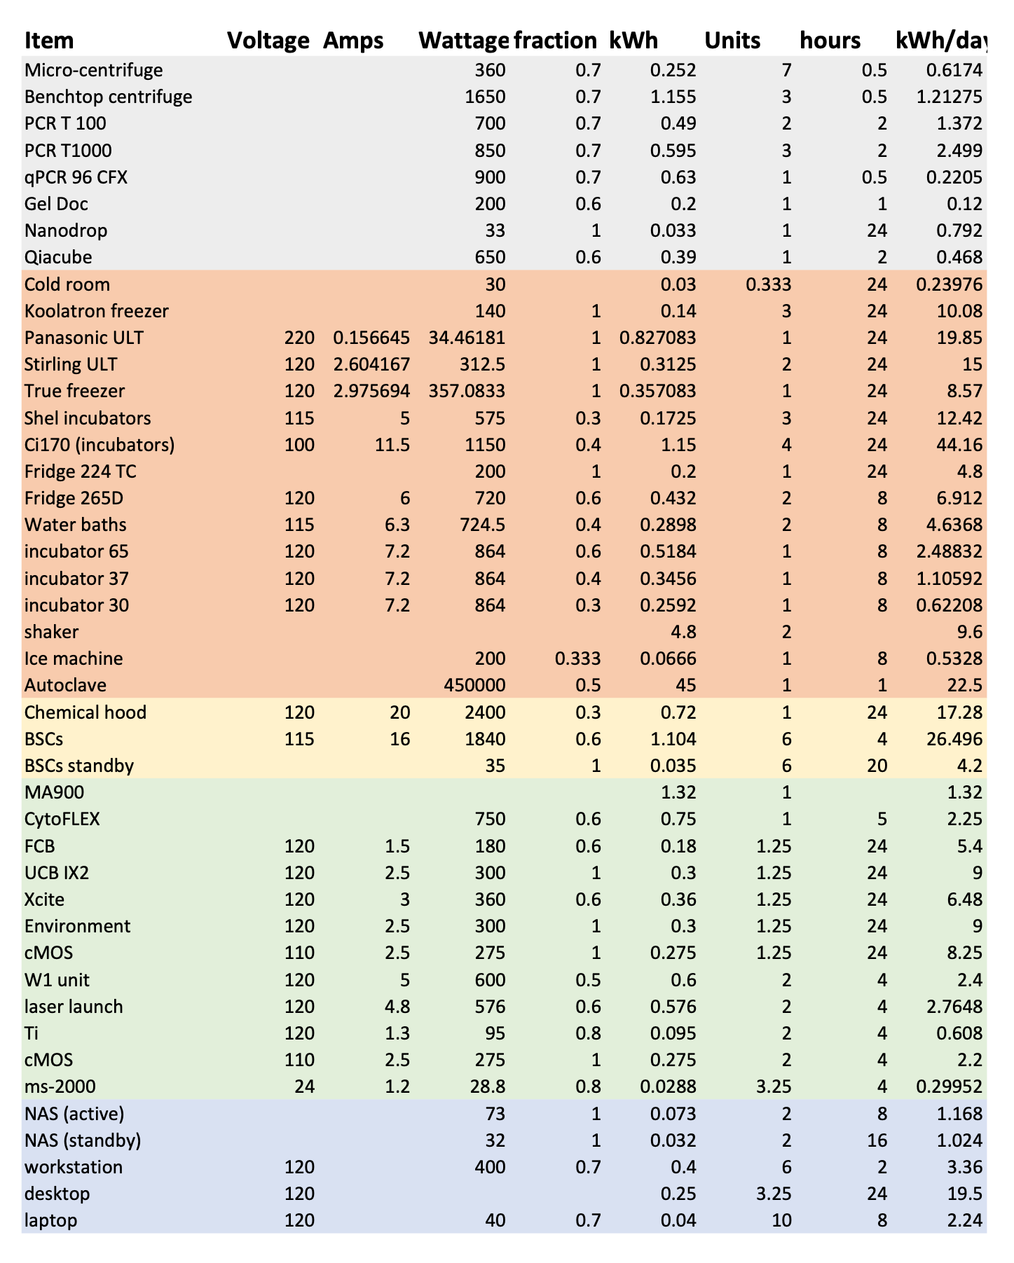
There are four categories
in the audit
Equipment
Temperature control
Instrumentation
Computers

Slide 13
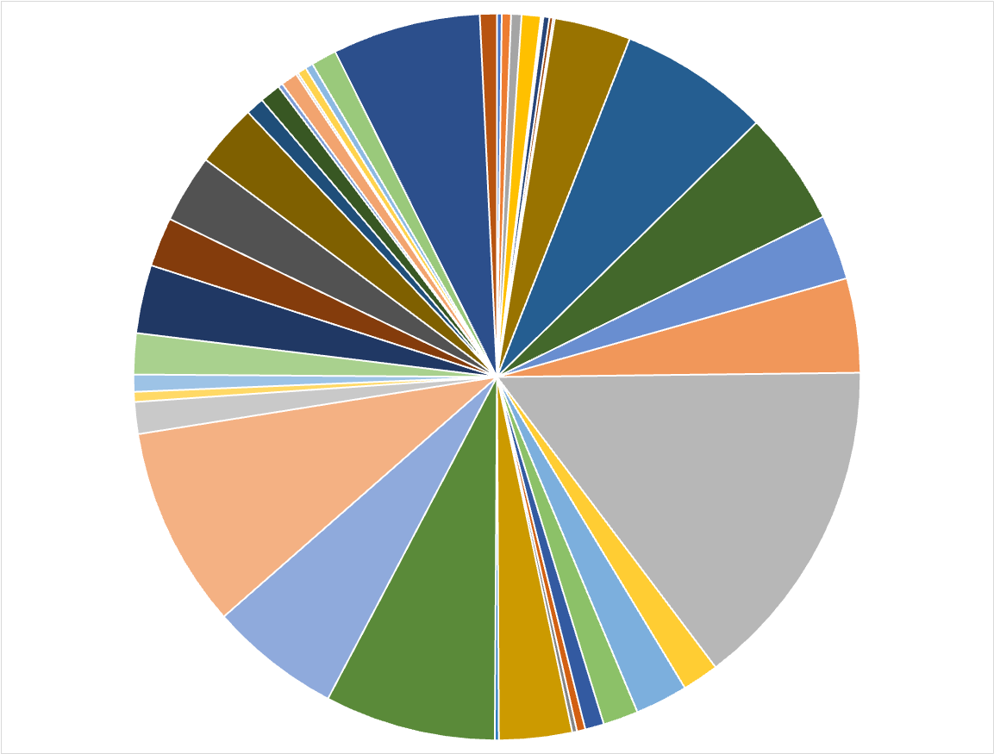
Itemized energy consumption reveals big consumers
Biosafety Cabinets
C170i incubators
Chemical Hood
Autoclave

Slide 14
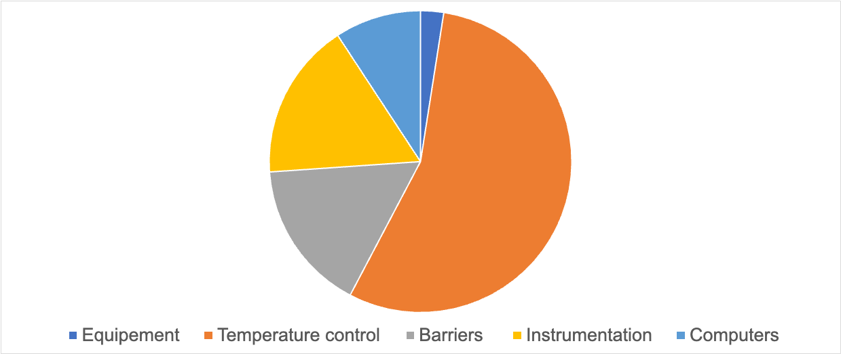
One category dominates lab energy demand

Slide 15
So what’s the bottom line?
296 kWh/ day
0.1184 metric tons of CO2 eq

Slide 16
Can you provide a scaling factor?
0.92 GJ/m²/year

Slide 17
Can you provide a metric for that factor?
0.92 GJ/m²/year
vs
4.54 GJ/m²/year
1. Mahler, S. et al. Energy-saving Strategies for New Research Facilities: Part 2. Lab Design Newsletter. 2010.

Slide 18
Can you make that number tangible?
43.2 metric tons of CO2/year
1 Person – Non Stop – Round Trip Flight – NYC to LA
24 flights
https://www.ecobusinesslinks.com/flight-emissions-calculator-comparison/

Slide 19
We are actively retiring select equipment
Floor model 37 ˚C shaker/incubator: 6.8 kWh/day
Large capacity -20 ˚C freezer: 8.6 kWh/day
Tissue culture incubator 37 ˚C: 4.1 kWh/day
Compact refrigerator/freezer: 3.4 kWh/day
Net reduction of 22.9 kWh/ day

Slide 20
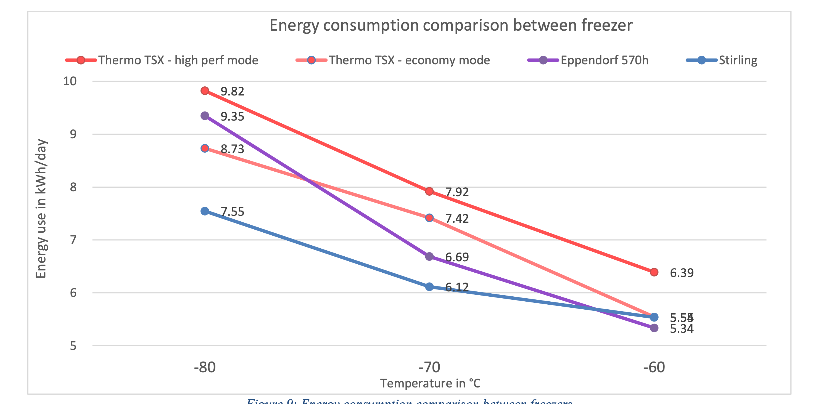
Reducing ULT freezer settings could save 522 kWh/year
Delphine Faugeroux, MS

Slide 21
We will build upon this audit
Continue to refine audit practices
Recruit lab members to help with surveillance
Consolidate equipment with neighboring labs

Slide 22
What now?
Start work on publications
  Survey! – James drafted and would like feedback

Slide 23
What now?
Start work on publications
  Survey!
  Mission Statement
As biologists, we are challenged to protect our environment and advocate for sustainable practices, as those actions protect the very thing we study: life on Earth. The Caltech Green Labs group aims to meet this challenge by proposing lab practices that are energy efficient, and resource efficient, without compromising research objectives. This group aims to create an equitable and inclusive space, where we can incentivise discussion utilizing the talents of staff, students, and faculty to promote innovation and normalization of sustainable laboratory practices. The Caltech Green Labs group ultimately aspires to be a resource for sustainable lab practices including energy efficiency, water conservation, green chemistry, waste management, sustainable purchasing, and sustainable education. These resources strengthen the Caltech community and further the Institute’s goal to positively impact the community at large.

Slide 24
What now?
Start work on publications
  Survey!
  Mission Statement
  Action Plan

Slide 25
What now?
Start work on publications
  Survey!
  Mission Statement
  Action Plan
  Newsletter
  (Guides, signage, website)
Begin planning for events
  Earth week and Green Labs Vendor Show?
    Talked to USA Sci Rep Trinity who had a cute idea of planting succulents in old tip boxes

Slide 26
Other Tasks (not started)
Newsletter introduction (needs BBE and Max approval before publication) - Elisha
  Submit by Jan.
  Visuals, simple, lead it to our website or meeting times etc, put some trivia in
Event(s)
  Earth Week April 2023, Vendor Show March 2023? (work with purchasing on date)
Green Labs Guide
  Draft on drive, submit by Fall 2023, update modules as we are able - – James will do energy and water, Elisha
Recycling Guide
  Submit completed version by Fall 2023
Recycling bin signage and freezer clean-out signage (laminated)
  Develop, pilot, adjust, and submit by Fall 2023
  Work with custodial services to see how we can work with them, increase efficiency etc
Pilot program newsletters
  As needed for quarterly BBE newsletters
Pilot Program Application – draft on drive, Kate tester
Survey – James, giveaway, Sarah, send to lab managers first, then poll rest of BBE, follow up with gifts
  Different avenues, energy, space
Notes:
Timeline by Jan
Budget
Action plan
website
Newsletter
Survey – add to website and show changes
- spring 2023
- first pilot
By Fall 2023
- GL guide, signage, newsletters,

Slide 27
For Next Time
Action Plan and Mission Statement
First “introduction” publication with BBE newsletter
  TC will draft and post on drive by Nov 18th , send to DW/MC Dec 16th
Green Labs Guide and other resources for website going online
  Is the drive working?
Anything Else?
Next Meeting December 9th 12pm Chen 322

Slide 28
Zoom link
Join Zoom Meeting
https://caltech.zoom.us/j/86357284963

